Slide 1

Complete Project Documentation
CUSTOMER SHOPPING BEHAVIOR ANALYSIS PROJECT
Data Analytics Team
January 2025

Slide 2

PROBLEM STATEMENT & PROJECT OBJECTIVE
Defining the Business Challenge
The Challenge: Difficulty understanding customer revenue contribution, product performance across categories, and the true impact of discounts on profitability.
Our Objective: Identify meaningful patterns in customer purchasing behavior, preferences, and spending habits through comprehensive transactional data analysis to drive strategic business decisions.

Slide 3

DATASET DESCRIPTION
3,900 transaction records
18 data columns analyzed
Data Foundation Overview
The analysis is built on 3,900 transaction records across 18 columns, capturing comprehensive customer shopping behavior. Demographics include age, gender, location, and subscription status. Purchase details cover items, categories, amounts, seasons, sizes, and colors. Behavioral metrics track discounts, promo codes, purchase frequency, review ratings, and shipping preferences. 37 missing review rating values were identified and handled through imputation.

Slide 4

DATA PREPROCESSING
Median imputation for missing values
Feature engineering & PostgreSQL
Python Data Cleaning
Data was loaded using pandas with structure checks via .info() and .describe(). Missing review ratings were handled through median imputation by category. Column names were standardized to snake_case format. New features were engineered including age_group and purchase_frequency_days. The cleaned dataset was then loaded into PostgreSQL for SQL analysis.

Slide 5

KEY SQL ANALYSIS FINDINGS
Top-rated: Gloves, Sandals, Boots
High-value discount users identified
Data-Driven Insights
Our SQL analysis of 3,900 transaction records revealed critical patterns in customer behavior and revenue generation. Male customers contributed higher overall revenue than females. Surprisingly, discounts did not reduce profitability—we identified high-spending customers who actively use discounts. Express shipping customers demonstrated slightly higher spending patterns.

Slide 6
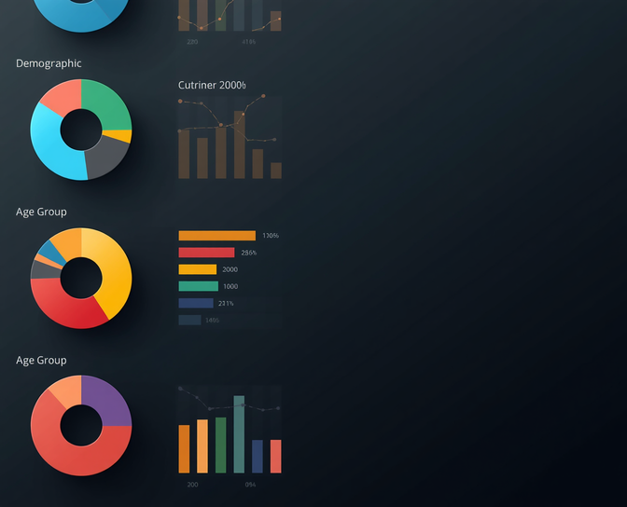
KEY SQL ANALYSIS FINDINGS
Hats and Sneakers were discount-dependent
Young adults drove highest revenue
Customer Segment Insights
Subscriptions improved customer retention but showed limited spend difference between subscribers and non-subscribers. Interestingly, many repeat buyers were not subscribers, indicating an opportunity to convert loyal customers. Young adults contributed the highest revenue among all age groups, making them a key target demographic.

Slide 7
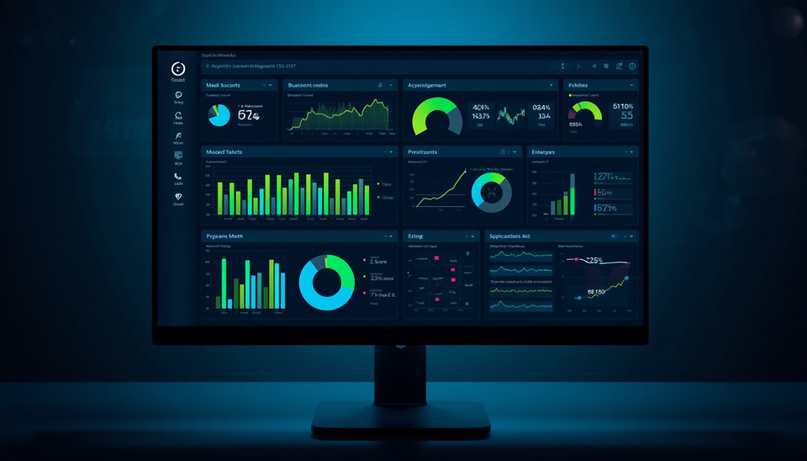
POWER BI DASHBOARD OVERVIEW
Interactive Data Visualization
Visualized key metrics: total customers, average purchase amount, and average review rating. Created revenue breakdown by category and sales analysis by age group. Implemented subscription status distribution charts with dynamic slicers for gender, category, and shipping type filtering.

Slide 8

BUSINESS RECOMMENDATIONS
Enhance subscription programs with exclusive benefits
Promote high-rated and best-selling products
Actionable Strategies
These data-driven recommendations leverage insights from customer shopping behavior analysis to optimize revenue, improve retention, and maximize the effectiveness of marketing and discount strategies across all customer segments.

Slide 9

CONCLUSION &
NEXT STEPS
Project Impact & Future Directions
• Demonstrated end-to-end data analysis using Python, SQL, and Power BI
• Delivered valuable insights into customer behavior and revenue patterns
• Identified strategic opportunities for business growth
• Next steps: Implement recommendations, refine dashboard, monitor KPIs

Slide 10

Thank you for your attention
We welcome your feedback and questions
THANK
YOU
Customer Behavior Team
Questions Welcome
Data Analytics
analytics@company.com

